Slide 1

Stratum
Prototype Presentation and Demonstration
Saturday, April 14
Jared Grimes
Erik Sangeorzan
Austin Wong
Kevin Zentner
http://hispanofrances.blogspot.com/2015/05/salir-de-fiesta.html

Slide 2
What is Stratum?

Slide 3
Students Who Study Music
40%
66%
46
increase in assignment scores
acceptance rate
into med school
points higher on the SAT
in the subjects of history, geography, math, reading, and even social skills of students with lower socioeconomic status who took music lessons
As opposed to students who don’t major in music
As opposed to students not taking music performance
http://www.childrensmusicworkshop.com/advocacy/factsandstatistics/

Slide 4
Agenda
1
4
Timeline of Project
What We Learned
2
5
Design
Future of Stratum
3
6
Features
Demo

Slide 5
Project Progression
Wave Theory
Keyboard and VGA Code
Finalization
Decided on what variation of sound to add, implemented triangle waves
Worked on implementing the main module, while starting to program the visual aspect
Implementation of layering, different instruments, and metronome was added
March 11 -17
March 18 - 24
March 25 - 31
April 1 - 7
April 8 - 14
Initial Code and Driver Compilation
Initial Draft and Additional Drivers
Started to code each module, while combining our drivers made from Lab 7
Finished up the initial working synthesizer, started working on touchscreen and SDRAM drivers

Slide 6
Time Spent on Each Task
40%
25%
20%
15%
Implementing layering and different instrument playing capabilities from SDRAM
Implementing triangle waves and note theory, never got to wave modulation in prototype
Adding touchscreen + VGA, along with designing a GUI for controlling various functions
Combining drivers, combinational logic, converting files for playback

Slide 7
Stratum was created with simplicity, functionality, and usability in mind.

Slide 8
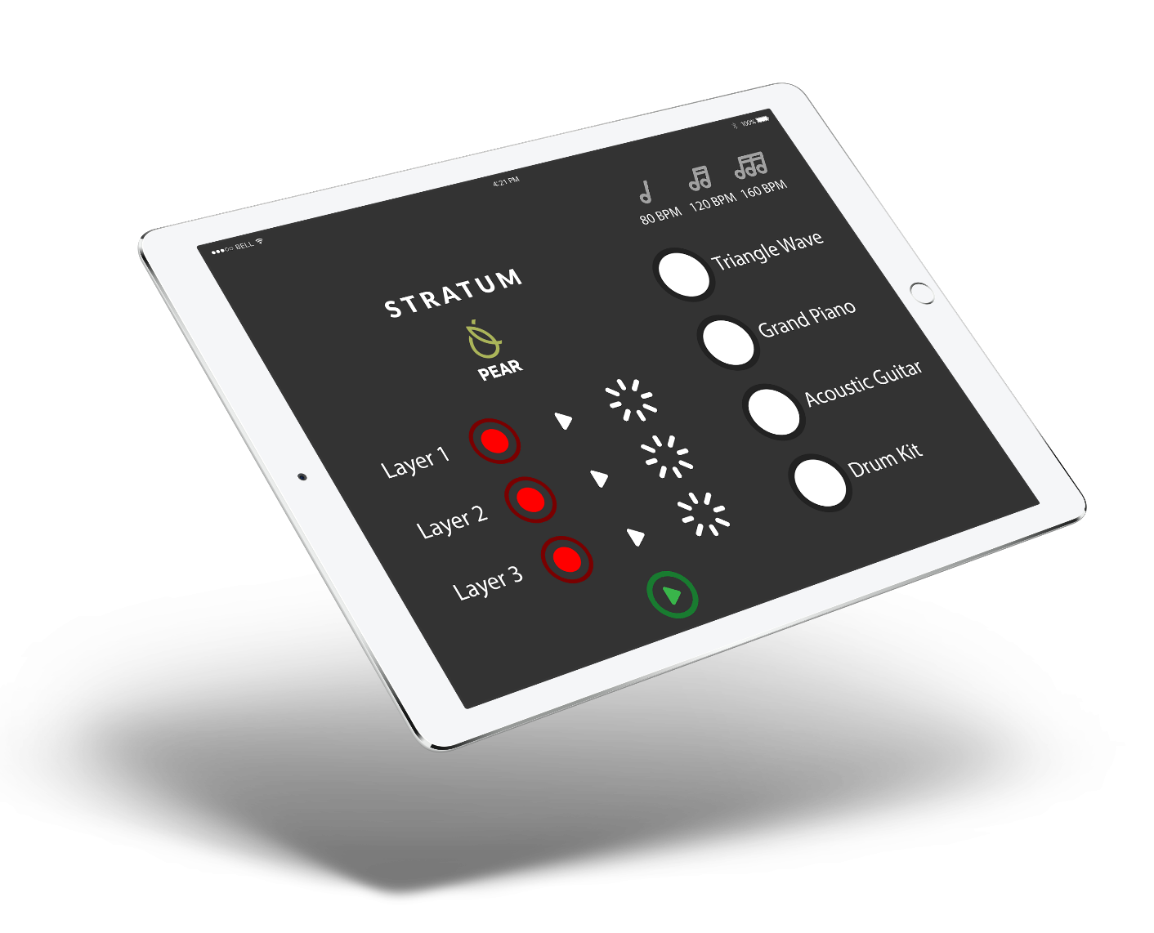
Design

Slide 9
Schematic

Slide 10
Getting notes to play when we hit keys on a keyboard
Most complex logic, converting key presses into numbers in an array
Playback
Modulation
Layering
User Interface
Adding more complex sounds via .wav files, starting to use SDRAM instead of E100 memory
Tying everything together with a visual interface for the consumer

Slide 11
Prototype vs Production
 | Prototype | Production
Processor | Altera DE2-115 | Raspberry Pi Zero
Display | 640 x 480 VGA Monitor | Elecrow HDMI 800x480 LCD Touchscreen
Speaker | Dell Mono Desktop Speaker | LQY Stereo Speakers
Keyboard | Dell Keyboard | Verbatim Slimline Keyboard
Price |  | $54.68

Slide 14
We didn’t get to implement wave modulation, and our triangle wave implementation could be improved

Slide 15




Coding in Assembly
Creating Functional Drivers
Designing User Interfaces
Theory of Sound
Skills Practiced

Slide 16
Future of Stratum
Increased variety in instruments and wave forms
Modulation effects to manipulate shape of waves
Advanced layering options

Slide 17
You asked, we delivered!

Slide 18
We will be demonstrating each instrument, multiple octaves, and layer functionality.

Slide 19
Thank you!

